Slide 1
Information Workshop for Parents:
Moving from secure to greater depth

Slide 2
Aims for tonight…
to have a clearer understanding of what "greater depth" writing means for children, parents and teachers
to look at some examples of "greater depth" lesson ideas and outcomes
to experience tasks that are aimed at developing greater depth skills
to go away with greater understanding of how you can help your children
Moving from secure to greater depth

Slide 3
What is “greater depth”?
Greater depth is all about giving the children the opportunity to “master” their understanding of key concepts and ideas
So, when we talk about greater depth, we are really talking about mastery of an objective, topic or subject
Moving from secure to greater depth

Slide 4
What is mastering something?
I know how to do it
It becomes automatic and I don’t need to think about it - for example driving a car
I’m really good at doing it – painting a room, or a picture
I can show someone else how to do it
Unconscious Incompetence
Conscious Incompetence
Conscious Competence
Unconscious Competence
Moving from secure to greater depth
Notes:
Next slide focuses in particular on Maths but skills are transferable.

Slide 5
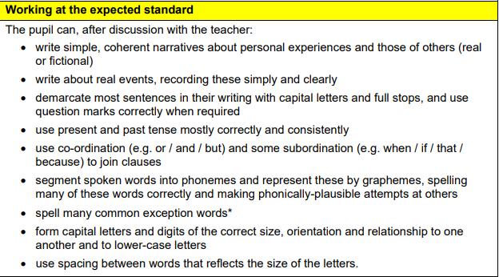
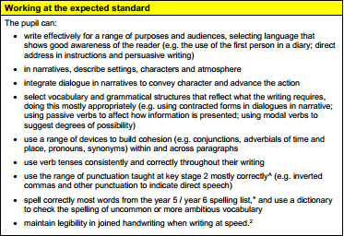
Writing at Key Stage 1 and 2
Notes:
Majority of children will be here

Slide 6
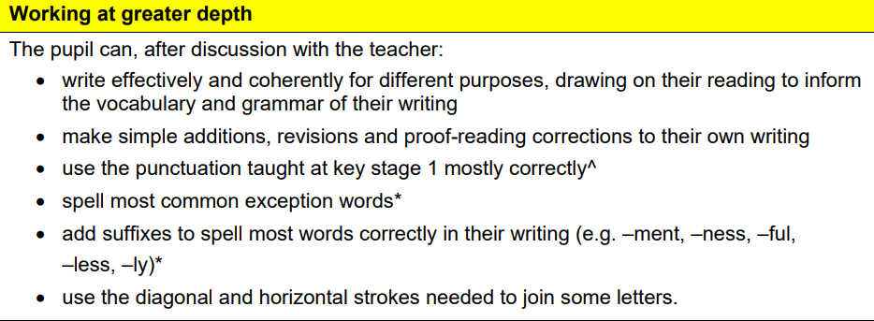
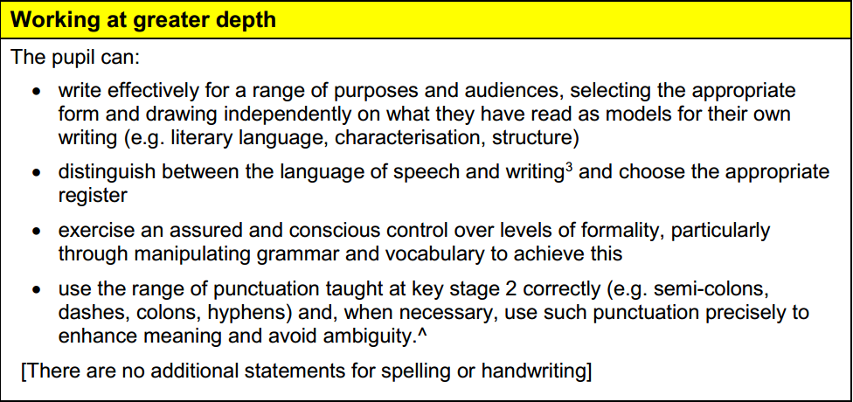
A key element at both Key Stages is the link with reading.
Notes:
What the requirements are for Greater Depth – reading is a key point…

Slide 7



Reading is an absolutely essential part of the whole writing process.
Reading together, reading for pleasure, discussing vocabulary, reading texts in class…
Notes:
Emphasise reading widely to enrich vocabulary, phrasing, authorial style etc

Slide 8
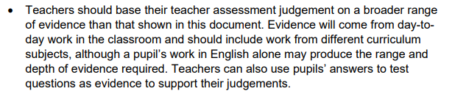
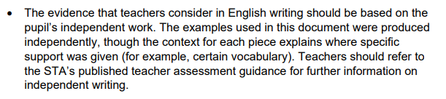
Writing: What are we looking for?

Slide 9
Control and Intent
Writer’s at Greater Depth do not just tick the boxes and follow a set of success criteria.
They have an understanding of how and why language is used and exercise control over their use of it.

Slide 10
How Can I Help My Child?
Writing:
Read with your child and discuss the book – words, character, writer’s style
Visit/join a library
Encourage “free writing”
Work with your child on their additional home-learning projects
Support with grammar tasks

