Slide 1
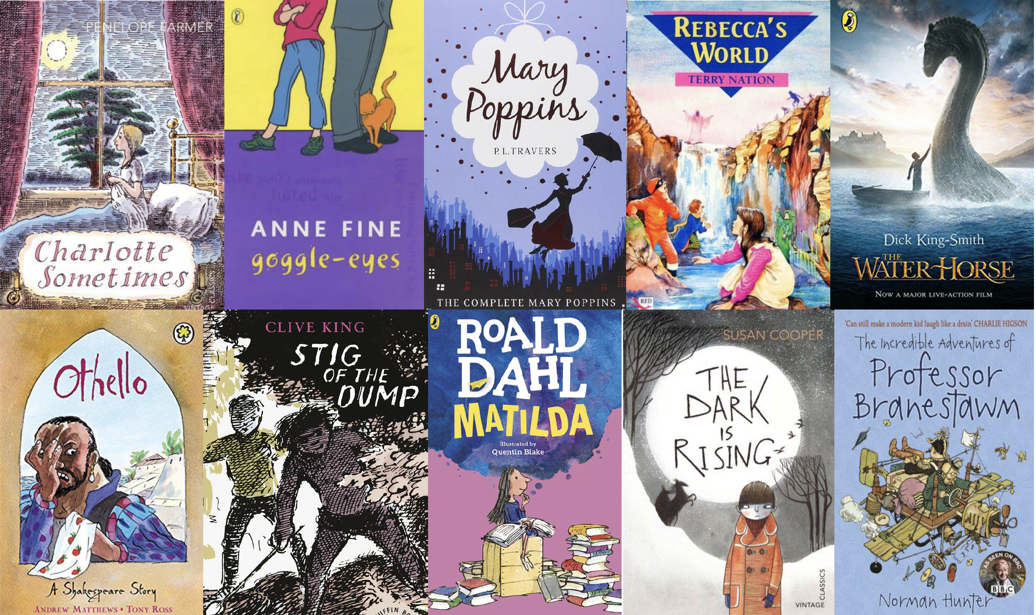
KS2 Reading: Parent Workshop

Slide 2
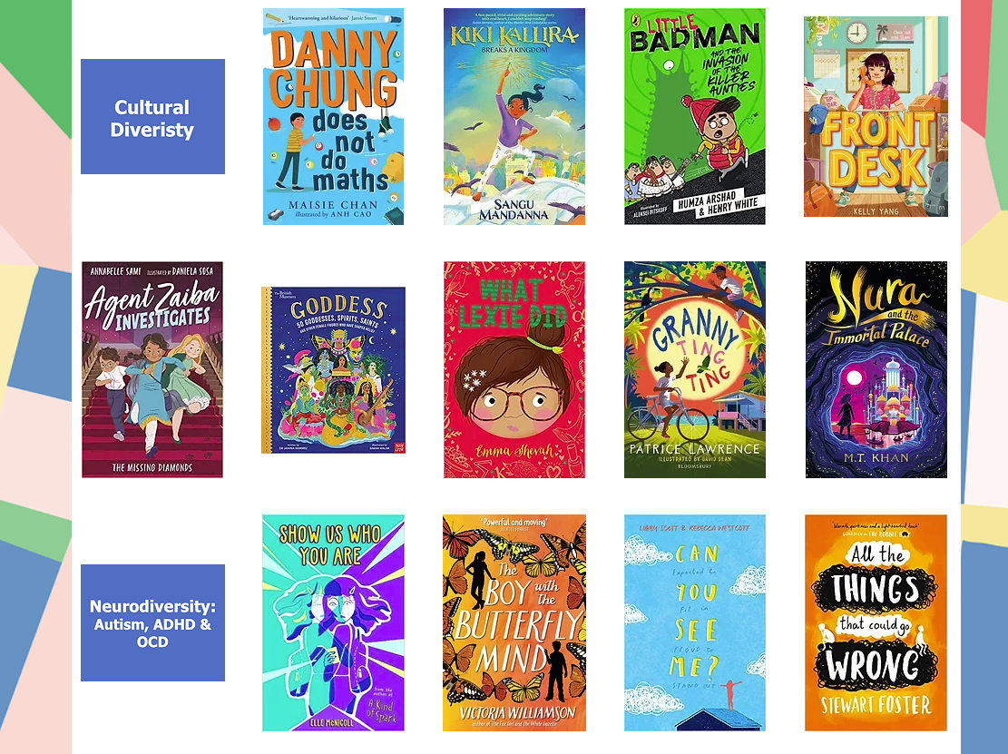
Expand your child’s reading repertoire
https://www.booksfortopics.com/upper-ks2-diverse-and-inclusive

Slide 3
Why?
Of all the help you can give your child, the most important job you’ll probably do is helping with reading. That’s because learning to read is best taught on a one-to-one basis, so giving your child a bit of shared reading time every day will make a big difference. They should be reading a range of genres and reading out loud to enable them to develop expression, intonation, confidence and fluidity in their reading. This should not stop even when a child becomes an independent reader.
We know that being able to read underpins everything a child does in school and is directly linked to their self-esteem, confidence and achievements as they go through life.

Slide 4

In 2013, The National Literacy Trust conducted a survey which included 11,000 children.
Children who read daily outside school were 5x more likely to perform above the expected level for their age in reading.

Slide 5
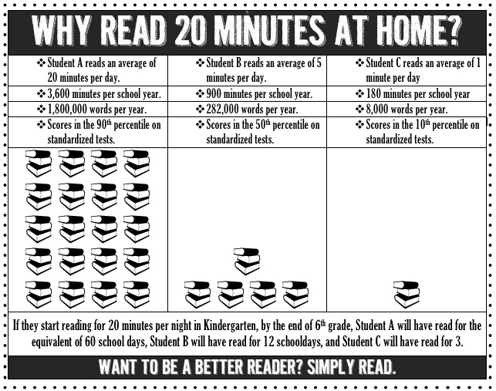

Slide 6
Reading has two components:
Word Recognition
(decoding)
The ability to recognise words presented in and out of context.
The ability to apply phonic rules - blending phonemes to decode (c-a-t)
High quality phonics work
Comprehension
The process by which word information, sentences and discourse are interpreted.
The same processes underlie comprehension of both oral and written language.
Continues to develop throughout life!

Slide 7

Comprehension and Decoding
I may have been able to confidently read (decode) but I didn’t really understand it!

Slide 8

KS2 Reading Journey
Before KS2:
EYFS – Beginning to learn phonetic sounds, hearing traditional tales and rhymes, acting them out
Year 1- Consolidating phonics sounds and beginning to decode for meaning (reading the words and understanding what they mean).
Year 2– Building on Y1 decoding for meaning and beginning to infer information from the text.

Slide 9
KS2 Reading Journey
Lower KS2
Year 3 & 4 - Note: At this stage, teaching comprehension should be taking precedence over teaching word reading directly.
Re-reading texts (both silently and aloud) increasing in speed and expression, discussing structures and purposes of wide range of texts, Identifying themes and conventions
Developing deeper inferences on characters’ feelings, thoughts and motives from their actions, and justifying inference with evidence
Identifying and discussing words and phrases that capture the reader’s interest and imagination
Using contents pages and indexes to locate information

Slide 10
KS2 Reading Journey
Upper KS2
Year 5 & 6 - Note: At this stage, there should be no need for further direct teaching of word reading skills for almost all pupils. (Reading effortlessly and confidently across all subjects with increasing automaticity when faced with unfamiliar words.)
Making sophisticated comparisons within and across books, increasing familiarity with a wide range of books including fiction from our literary heritage, and other cultures
Compare characters, viewpoints with a deeper critical thinking around themes and conventions, summarising ideas, exploring word meaning and key details & sophisticated and well-argued inferences around characters’ feelings, motives, thoughts etc justifying with clear evidence/thought process
Discussing and evaluating authors use of language and considering impact
Skills of information retrieval - e.g. topic textbooks, reading information leaflets before a gallery or museum, reading a theatre programme or review
Participate in discussions about books that are read to them and those they can read for themselves, building on their own and others’ ideas and challenging views courteously, provide reasoned justifications for their views
Year 5 as an introductory phase
Year 6 as a consolidation and mastery phase

Slide 11

To deduce, infer or interpret information - what does it all mean?
Statement | Explanation | Example Questions
Deduce, infer or interpret information, events or ideas from texts | Put together the underlying meaning in a story/text Being able to solve the puzzle | Why was Red Riding Hood not afraid in the forest? Why did the Wolf dress up as Red Riding Hood’s Grandmother? How did Red Riding Hood know that he wasn’t the Grannie?

Slide 12
Identify and comment on the structure and organisation of a text - what does it all mean?
Statement | Explanation | Example Questions
Identify and comment on the structure and organisation of texts, including grammatical and presentational features of the text. | The choices that writers make in the way a book looks – Chapters, sub headings, rhymes in the text, italic print, complex sentences And WHY THOSE CHOICES HAVE BEEN MADE | Why do you think the chapter ends there? What is the writer making us feel? Why is there a new sub-heading for this part of the book? Why has the writer chosen to put a rhyme in the middle of the text?

Slide 13
Explain and comment on the writer`s use of language - what does it all mean?
Statement | Explanation | Example Questions
Explain and comment on writer’s use of language including grammatical and literary features at word/sentence level | Looking closely at the key words/phrases a writer uses Identifying powerful verbs, unusual adjectives, similes, metaphors, unusual connectives | What is the simile that the writer uses to compare the wind? Why is this a good phrase? Why does the writer use this phrase to being the sentence? How does it make you feel? Why?

Slide 14
Identify and comment on the writer`s purposes and viewpoints - what does it all mean?
Statement | Explanation | Example Questions
Identify and comment on writers’ purposes and viewpoints and overall effect of the text on the reader | Is there an underlying message in the story/book? e.g battle between good and evil; pollution and green issues; being kind to each other etc AND HOW SUCCESSFULLY THIS VIEWPOINT HAS BEEN PUT OVER | What do you think was the point of the story or book? Did the writer convince you that his ideas were right? Why/Why not?

Slide 15

Reading for Pleasure
Reading should be fun – that way they will want to read to you. Here are some tips:
Book Talk!
Be an active listener – sit and listen, asking questions showing interest
Share more advanced books with your child - read to your child:
This is an opportunity for them to hear stories and language at a higher level than they can read alone. Research shows the hearing texts read aloud is a significant source of vocabulary acquisition. Use audio books/ Amazon Audible.
Keep positive!

Slide 16
How can adults support children in their reading at home?
Expectation: ideally, at least 20 minutes per day.
• Try to build this into your daily routine – even better if you can make it the same time of the day.
• Have a quiet, comfortable space your child (and you) can read in.
• Read with your child and read in front of your child.
We can teach reading skills in school. We want your support in encouraging independent reading and in engaging in your child’s reading. d hearing texts read aloud are important.

Slide 17

How can adults support children in their reading at home?
Before Reading
If it is the first time your child has read the book, look at the cover and title with them to predict what they think the book might be about.
Make links to other books read with similar themes, the same characters and/or similar authors/illustrators.
Give them time to flick through the book and read the blurb.

Slide 18


Questions during or after…
Retrieval
• Engage in comprehension monitoring – does you child understand what they have read?
• Can they understand the causal link between desires, motives, actions, goals and consequences?
• For retrieval questions the answer is in the text.
• Children need to skim and scan for key words using their magic finger.
Inference
• Children have to search for hidden clues in the text (often show not tell e.g. her mouth dropped open).
• Relies on own understanding of world / experiences and on understanding of language.
How did Ahmed feel? Sukie was a stubborn character. True or false? Why did the man feel impatient? In what way was the gang like a family

Slide 19
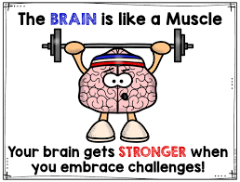
Growth Mindset
All readers make mistakes. This is how we learn. Encourage a growth mindset in your child by praising them for recognising their mistakes and trying to fix them.
‘This is what you said ….. Can you spot anything wrong with that?’ ‘Does that make sense?’

Slide 20

What to do if your child is stuck:
Use phonics first. What sound does the word begin with? Can you say the sounds in the word? Blend them together.
Read to the end of the sentence. What would make sense?
What is the text about – what might fit here?
Does it sound right?
Look at the picture. Does it help?
What is the root word? Does this help? (friendly)
Chunking the word
Always use your own parental judgement. If your child is tired or feeling unconfident, shift the balance of reading more towards you.

Slide 21
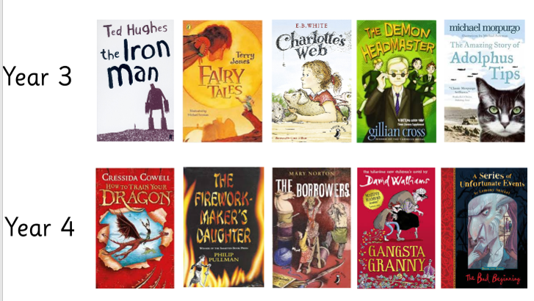
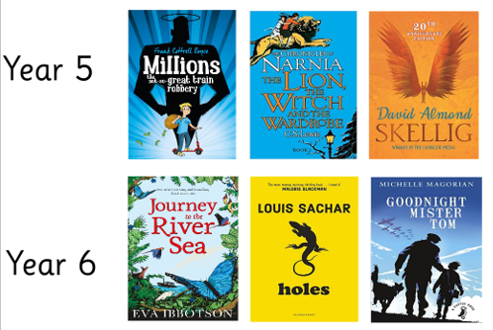
Core Texts

Slide 22

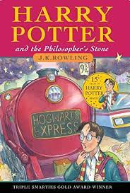

Any Questions?
https://schoolreadinglist.co.uk/category/reading-lists-for-primary-school-pupils/
All resources will be uploaded onto the school website.
Thank you for coming!

