Slide 1
RWInc. Fresh Start

Slide 2
What is Fresh Start?
Read Write Inc. Fresh Start rescues students aged 9 and above who are reading below age-related expectations (including children with SENs), using a phonics-based approach. It enables them to become confident, fluent readers, who can access the wider curriculum.

Slide 3
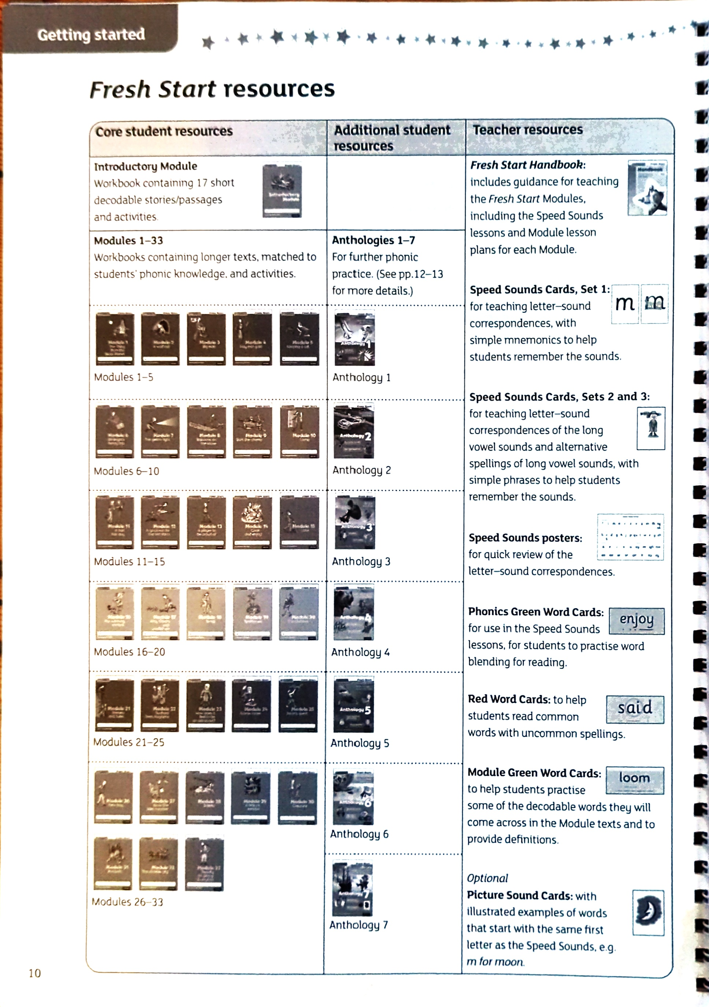
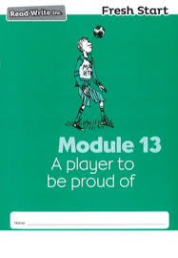
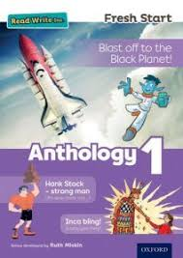
How does Fresh Start work?
Fresh start is made up of 33 Modules workbooks.
There are 7 Anthologies that allow for further practice.

Slide 4
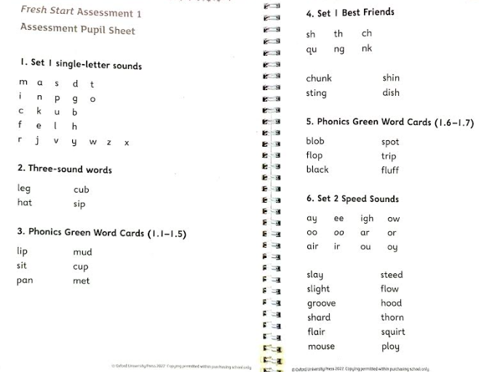
Assessment – where to start
Before children start their fresh start journey they are assessed to see where their starting point is.
Assessments are in the hand book and can also be downloaded from Oxford Owl.
The assessment determines whether the child is struggling with word reading (decoding), language comprehension or both.

Slide 5
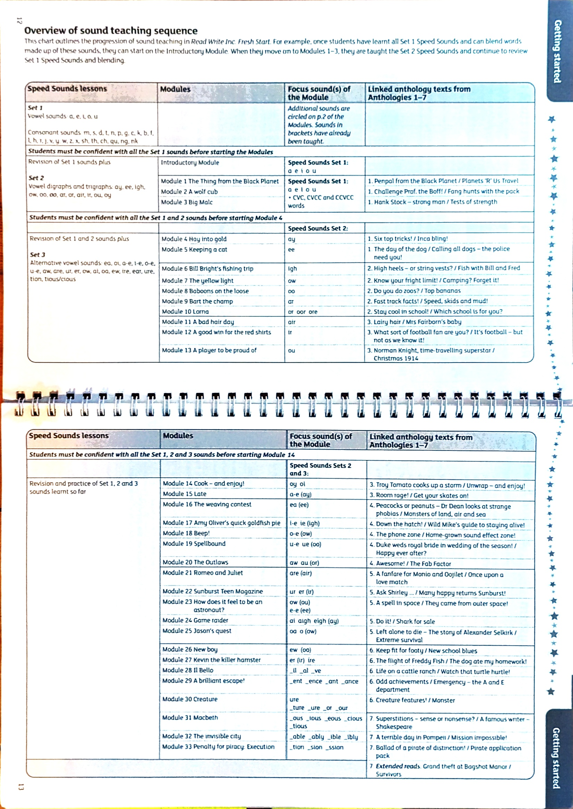
Overview of sound teaching sequence

Slide 6
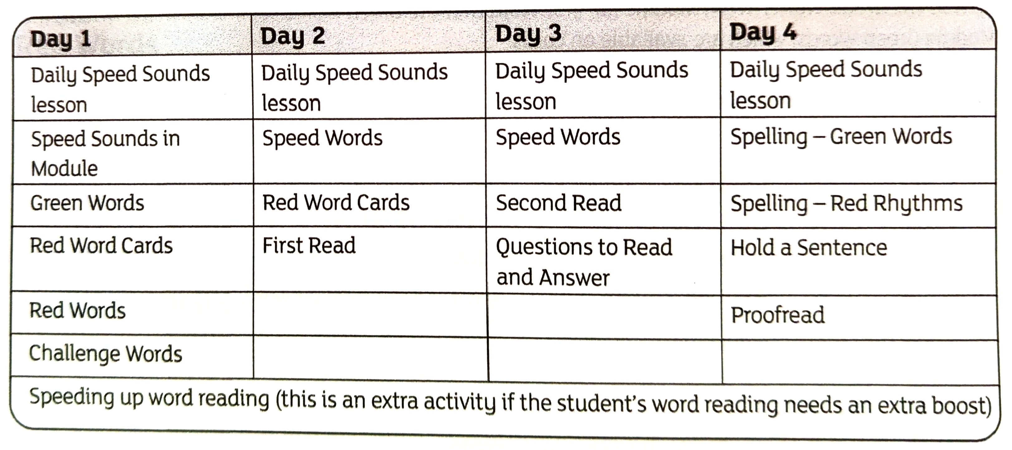
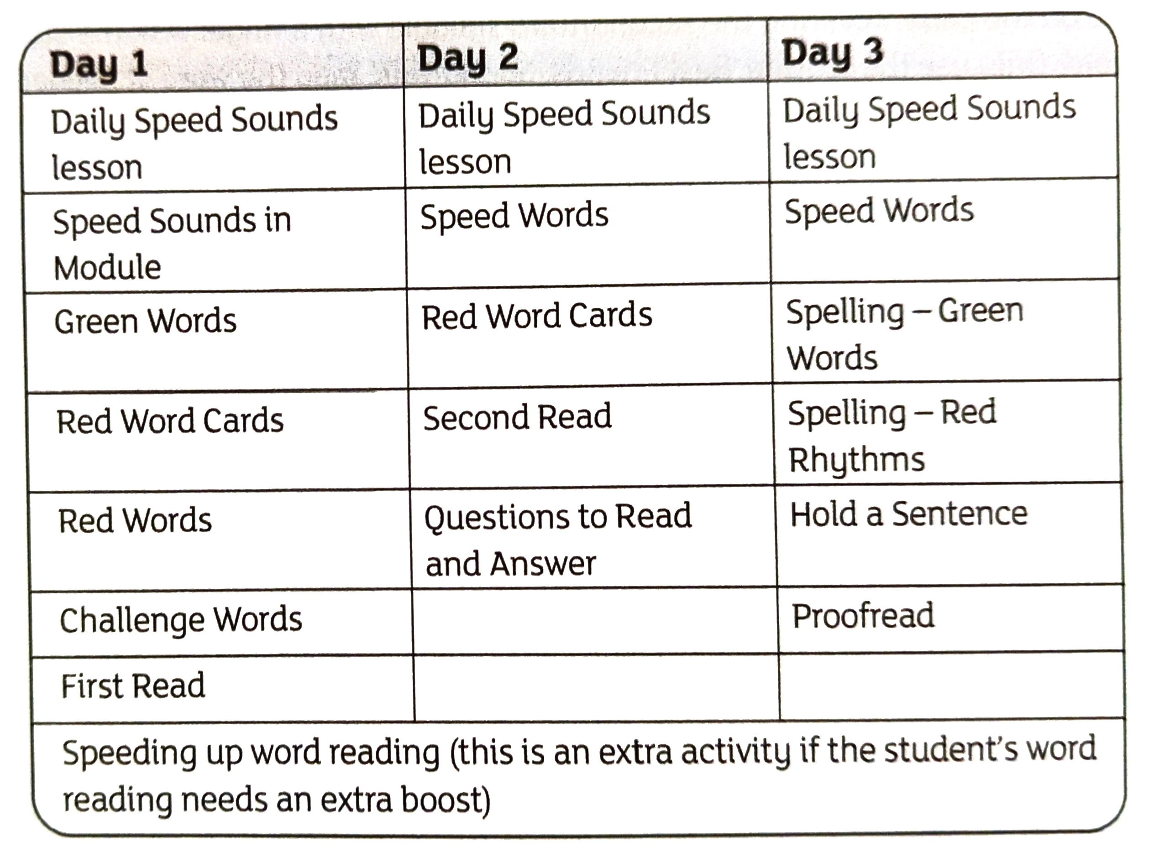
How the sessions run
Sessions can be 1:1 or small group.
They should take 20 mins a session.
Children learn two new sounds each day.
All lessons are broken down in the handbook.
All resources for each module can be downloaded f from Oxford Owl.
Notes:
I module over 4 days
As children progress you could move to q modules over 3 days.
You will notice children read the text three times – this is build stamina, prosody and comprehension.
By the third read children are not having to decode the words, this reduces the cognitive load and there children can start to comprehend what they have read.

Slide 7
Learn the Sound System
There are 44 speech sounds
  20 vowel sounds and 24 consonant sounds
  Speech sound
We only have 26 letters in the alphabet to write all the 44 speech sounds
  Sounds are sometimes one, two, three or four letters.
  c in cat
  ay in day
  igh in night
  ough in thought
Notes:
CHILDREN WILL LEARN:
Sound is the smallest unit of sound that we can hear of speak.
Grapheme indicates the written version of the sound.
Speech sound – changes meaning of word e.g. man if you swop the m for a p becomes pan.
c in cat
ay in day
igh in night
ough in thought

Slide 8


Learn the Speed Sounds
Set 1
Set 2
Set 3
Consonant sounds – stretchy
Consonant sounds – bouncy
Sounds talk
Best friends
Green words
Red words
Notes:
Hand out sounds sheets
Ffffff, llllll
Bbbbbbbb, ccccccc
Sounds talk – teacher sounds it out and the children blend it.
Teacher says C-a-t child says cat
Best friends – combined of 2 or 3 letters representing one sounds e.g. ck, sh, ph a-e.
Green words – words with common graphemes and always taught using sound-blending
Red words – (tricky words) – they can not be sounded out and need to be learned through sight reading.
ACTIVITY 1 – pair up with someone who is an expert if you are less confident. Start by sorting the set 2 and 3 sounds in to piles by set and say the sounds as you do it.
ACTIVITY 2 – Can you now sort the green and the red words into piles?
ACTIVITY 3 – Underline the best friends!
ACTIVITY 4 - Practice using sound talk
Activity 5 – Circle the sounds which make the red words tricky!

Slide 9
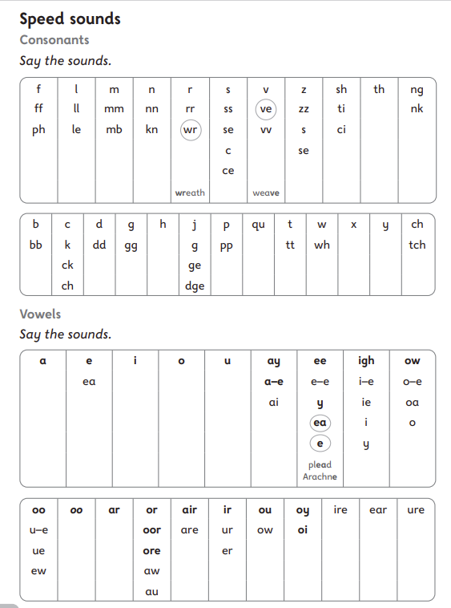
What does this look like in a module?
Page 2
Notes:
Daily speed sound practice. Module 16 is set 2 and 3.
Use your cards to practice this.
Jumble them up!
Turn to Page 2 – Speed Sounds
Introduce ea and (ee) as the new sounds-
ea cup of tea and
ee what can you see.
Explain that all sounds in a box are the same
Point and ask child to say the sound especially the circled sounds.

Slide 10
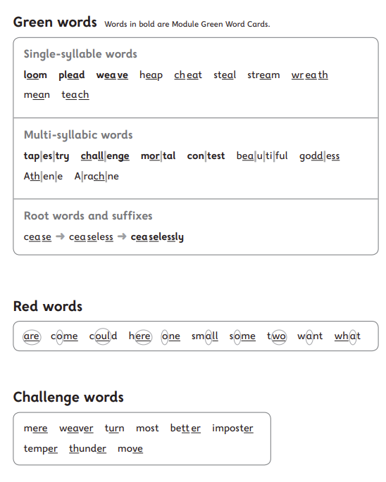
What does this look like in a module?
Page 3
https://www.ruthmiskin.com/programmes/fresh-start/about/
Notes:
Green words
Best friends
Sound talk
Read the word.
Red words
Recap the previously taught red words.
Introduce new red words
Say the word – ask the children to repeat it.
Point to the card and say the sounds you can hear s-e-d
Point out the tricky part of the word
Ask children to read again.
Challenge words
Few extra words from the story with sounds they may not have learnt yet.
Ask I they know any words
Read each word to them and they repeat (my turn, you turn)

Slide 11
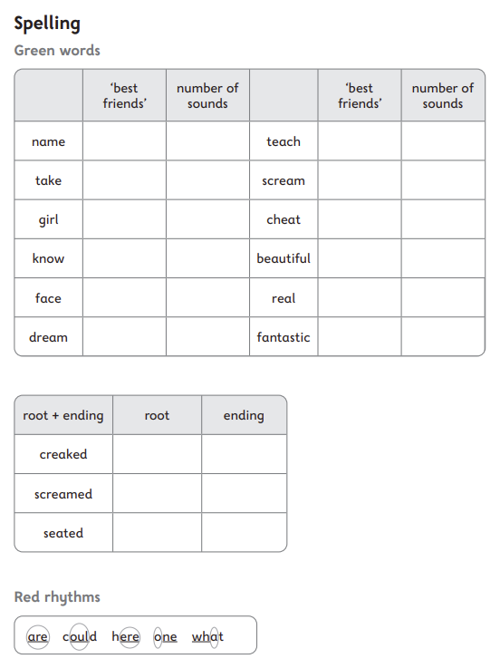
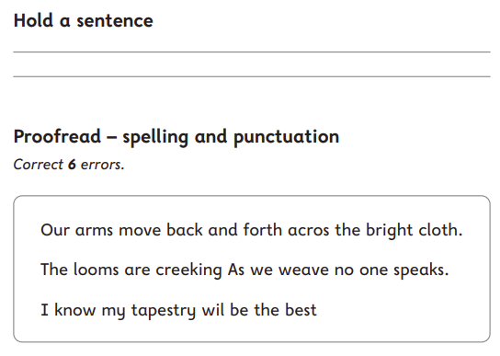
Spelling
Green words – dot and dashes and count the sounds.
Red words – Read the word ins sounds then write the word.
Hold the sentence – Say the sentence and the child repeats it and then they write it. You mark the sentence together.
Proof-read – children follow while adult reads the sentence, child then find the errors and corrects them and mark together.

Slide 12
Other Bits!
We have Anthologies (1-7) that accompany groups of modules. They are there to promote and motivate children to read for pleasure.
  Non-fiction
  Poetry
  Fiction texts
Children can be given homework. This is downloaded from Oxford Owl.
  Building vocabulary
  Grammar practice
  Writing task
Notes:
Anthologies – provide further practice.

