Slide 1
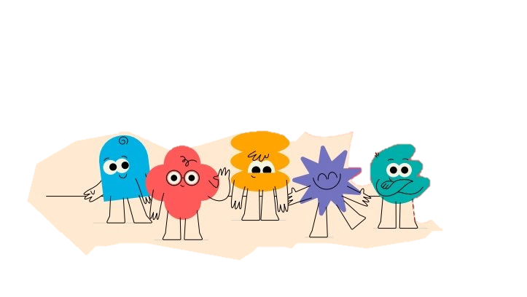

Created by Southampton Neurodiversity Multidisciplinary Team (2026)
Objectives
To improve understanding of ADHD
To better understand anxiety and threat in ADHD students
To better understand neurodivergent masking.
To apply knowledge about ADHD in your setting to reduce barriers for ADHD students.
Understanding ADHD
A practical, needs-led lens for teaching staff.​

Slide 2
Ice-breaker: ADHD myth or reality?
People with ADHD can't pay attention.
ADHD affects mostly boys.
Hyperfocus can be part of ADHD.
ADHD can be present when there are no signs of hyperactivity.
ADHD is not a neurodevelopmental condition.
People with ADHD can pay attention but may find it harder to regulate their attention.
ADHD affects people of all genders. Historically, boys have been identified more, but many girls were missed due to presenting differently.
Some people with ADHD experience hyperfocus, becoming deeply absorbed in an activity or interest
Some people have inattentive ADHD where difficulties with attention, organisation and working memory are more noticeable
ADHD is a neurodevelopmental condition. It is not a social construct. This means it relates to differences in how the brain develops and processes

Slide 3
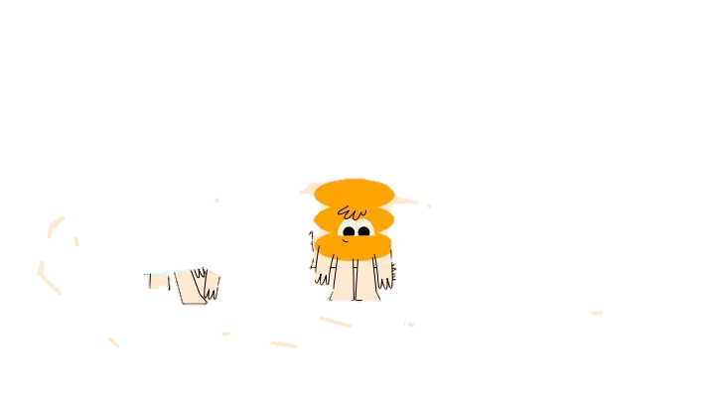
What is ADHD?
Sources: NICE NG87; CHADD educator overview; CDC
ADHD is a neurodevelopmental difference that can affect how a person regulates attention, activity, impulses, emotions and planning. It is intentionally defiant behaviour.
Core areas
In school this may look like
Attention regulation
Activity and energy level
Impulse control
Executive functioning
Emotional regulation
Opposition
RSD (rejection sensitivity)
Starting/finishing tasks feels hard
Work pace varies
Instructions are missed
Equipment or tasks are forgotten
Small triggers cause big reactions
Engagement peaks with interest
Important: Different presentations mean not every pupil will look hyperactive, inattentive or impulsive in the same way.
A closer look at ADHD
Anxiety and threat
Masking and relationships

Slide 4
Celebrating strengths
Strengths and needs often come from the same underlying differences.
Strengths to notice and celebrate
Creativity and original thinking
Energy, enthusiasm, humour
Hyperfocus or increased engagement when interest is high
Fast associative thinking
Problem-solving and adaptability
People skills
ADHD individuals may not yet be aware of their own strengths
Pair strengths-based language with explicit support “You bring great ideas; let’s use a tickbox list with dates to help capture and finish them.”
Notes:
2 min
Ask delegates to offer some examples of ADHD strengths or support areas they see in the setting
Ask delegates to offer some examples of ADHD challenges or support areas they see in the setting
Share that students may or may not have a good self awareness of their own strengths and challenges and

Slide 5
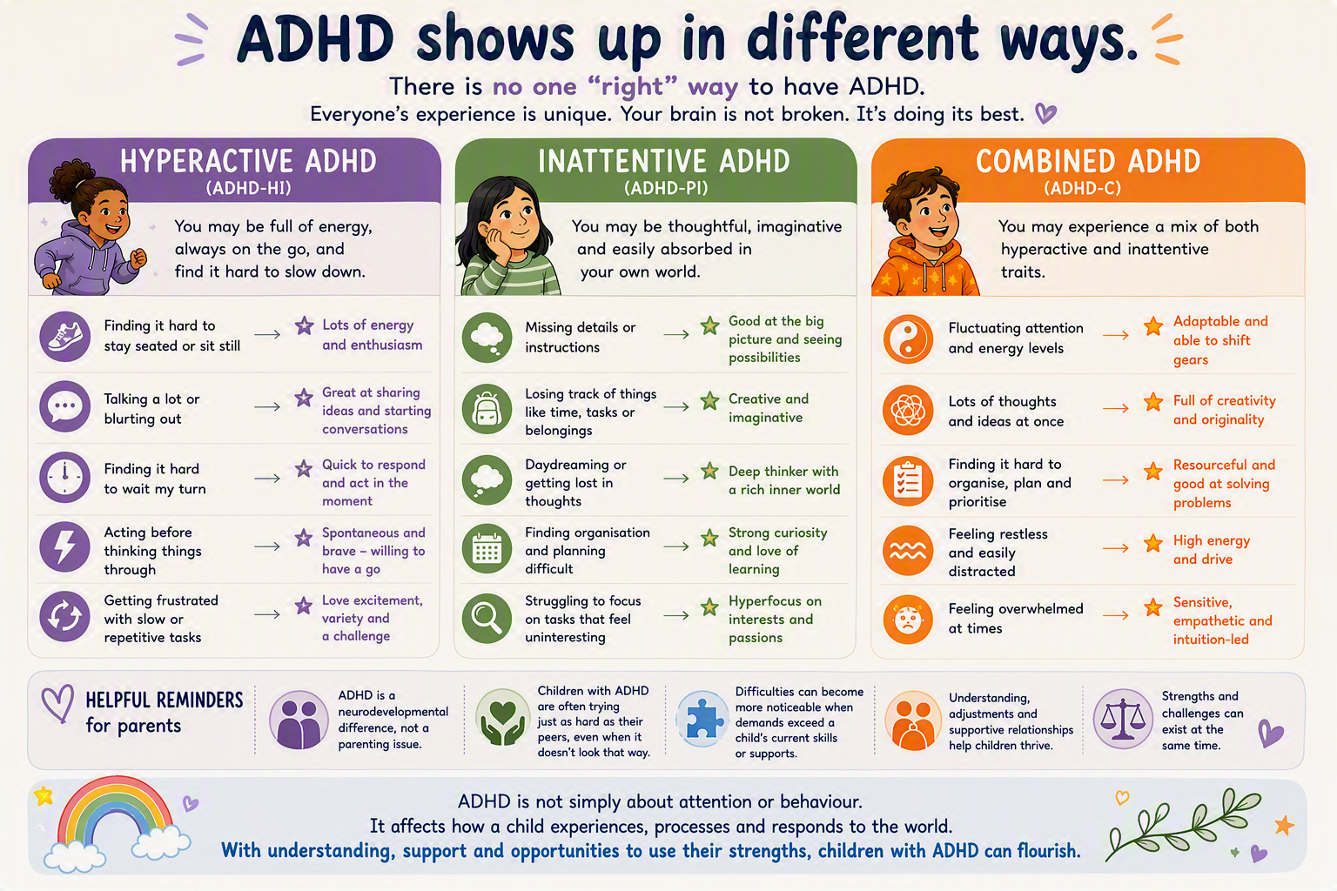
A closer look at ADHD
A Closer Look: 3 presentations
ADHD can be diagnosed with three different presentations (for more info visit adhduk.co.uk/about-adhd)
Most common
50-75%
Q: Do we often have this level of information about the presentation and diagnosis of ADHD in cyp?
Notes:
5m
Hyperactivity – External and Internal
Hyperactivity is linked to greater variability and speed of thought.
A large 2025 study in Scientific Reports found that hyperactive ADHD traits (not inattentive traits) were associated with:
Rapidly shifting thoughts
Increasing variability in thought content
A ‘freely moving mind’ especially in low structure situations.
Both hyperactivity and inattention are differences in attention regulation, not effort, motivation, or intelligence.
Hyperactivity is often a mind that won’t slow down; inattention is often a mind that won’t stay with one thing

Slide 6
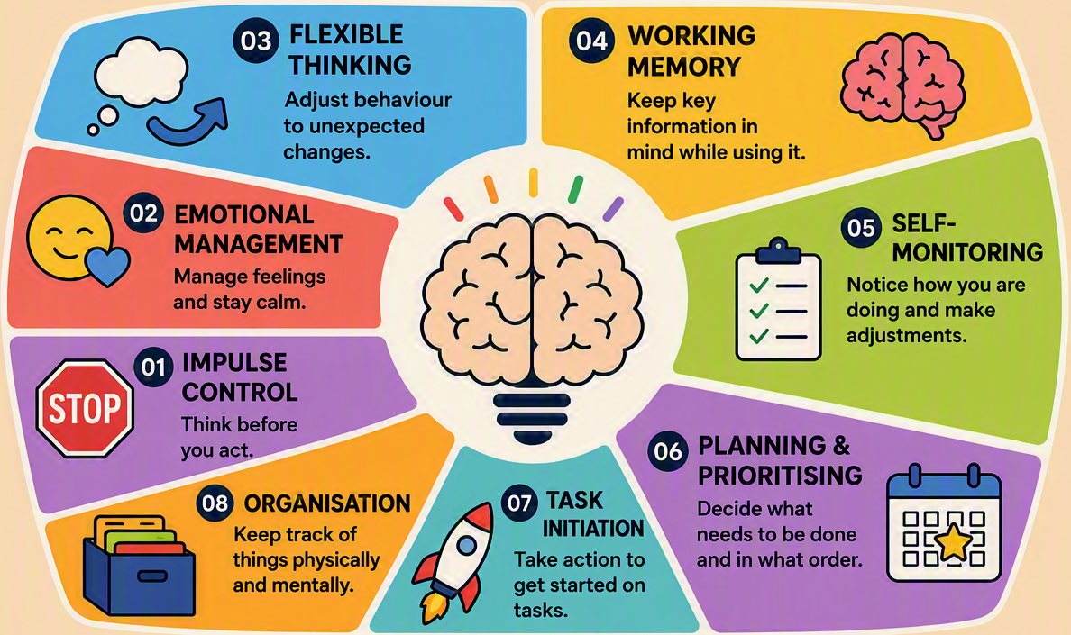
A closer look at ADHD
A Closer Look: Executive function skills
By age 7, most children with ADHD have a 2-3 year delay in the development of executive functioning skills. (NIMH)
Add citations!

Slide 7
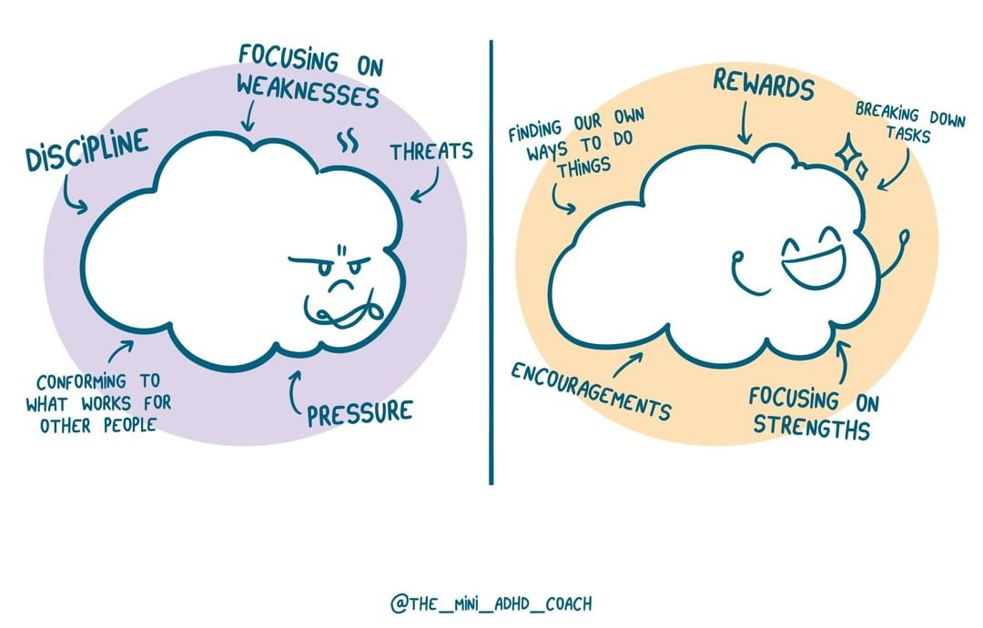
A closer look at ADHD
A Closer Look: other challenges
Other challenge areas
Time awareness
Transitions, waiting, turn-taking
Some experience sensory differences
Emotional regulation and rejection sensitivity
Notes:
2 min

Slide 8
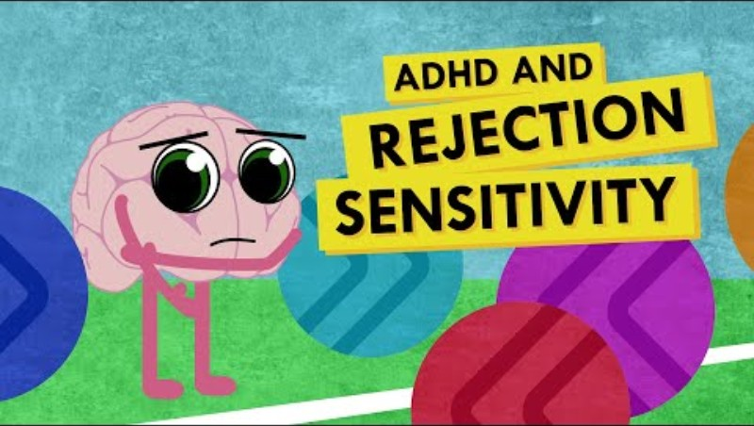
A closer look at ADHD
A Closer Look: RSD, rejection sensitivity

Slide 9
A closer look at ADHD
A Closer Look: clinical and psychological
Clinical lens
Psychological lens
School lens
Developmentally different patterns persistentt across settings
Diagnosis considers context, history and co-occurring needs
Medical model for disability and may use deficit-focused lang
Treatment and medication
Executive function impacts
Attention is regulated by interest, novelty, emotion and demand
Emotion regulation and motivation can be variable
Presentation varies by lesson, adult and time of day
How to reduce cognitive load
Co-regulate first; reflect and problem-solve when calm
Inclusive environment
What adjustments are possible to remove barriers
Helpful reframe: “Can’t yet" not "won’t.” Look for the skill, demand or environment that needs adjusting and developing.
Sources: NICE NG87; NIMH ADHD overview; DSM-5 diagnostic criteria summary
Notes:
Share with delegates that different lenses impact how professionals and individuals understand and support ADHD.
Clinical: for assessment and diagnosis: patterns must be persistent, developmentally different, and seen across settings. Diagnosis considered co-occurring needs. May use a medical model for disability or deficit-focused language. May focus on medication treatment options. Not all clinical staff use deficit-focused framing anymore (things are changing) – but this is still in the DSM-5 (diagnostic and statistical manual of mental disorders 5th ed)
Psycological lens: focus on executive functioning challenges such as working memory, planning, task switching etc. and impact of cognitive load. Attention and emotional regulation is relevant.
Education/schools lens: Presentation can vary by lesson, adult, time of day etc. Important to try to reduce cognitive load and sense of threat with routines, instructions and visual prompts. Focus on co-regulation. Focus on inclusive environments and adjustments.

Slide 10
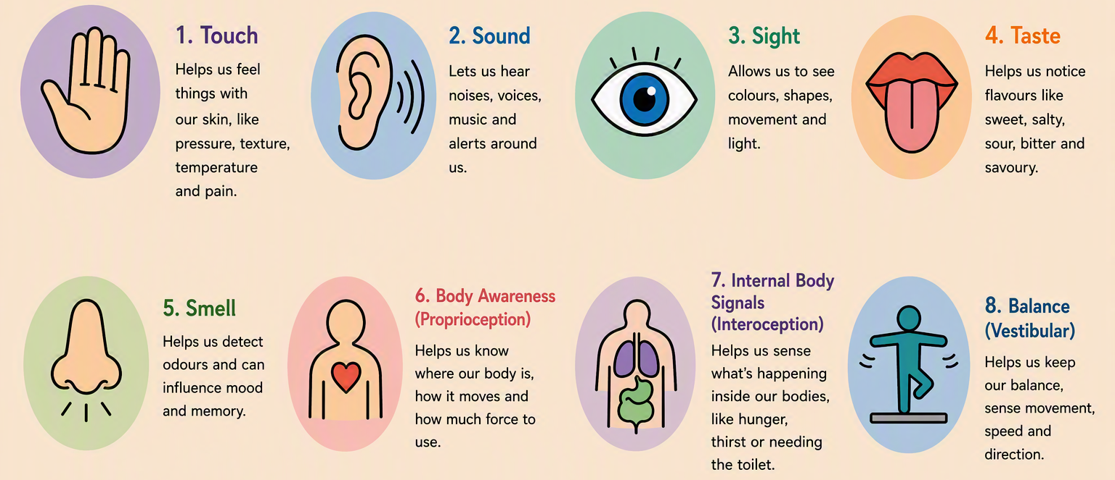

A closer look at ADHD
A Closer Look: Senses
Many ADHD people, like those with other neurodivergent conditions, can sometimes experience sensory differences
An individual might have a unique sensory profile where some senses are over responsive and others are under responsive. Look at the Sensory Supports info and checklist on the SCC webpage for more information.

Slide 11

Anxiety and threat
Anxiety: Causes
What’s causing general anxiety in young people?
Social media
Iceberg
School performance, perfectionism, testing, expectations
Extra-curricular performance: sports, video games
Sensory overwhelm in the environment
Health: pandemic impacts, conditions, sleep, diet, rest
Signs of anxiety you might see:
Procrastination, difficulty concentrating, somatic issues (headache, stomach-ache, heart pounding), tearfulness, stubbornness or resistance to demands, meltdowns, avoidance, perfectionism, irritability, arguing or pushback, hiding, running away, fatigue, increased rejection sensitivity
Peer relationships, development, puberty
Home instability, poverty, trauma, violence
Notes:
Ask delegates to think about what could be causing anxiety in young people at school. Delegate could discuss how this anxiety might be impacting behaviour and presentation in schools.

Slide 12
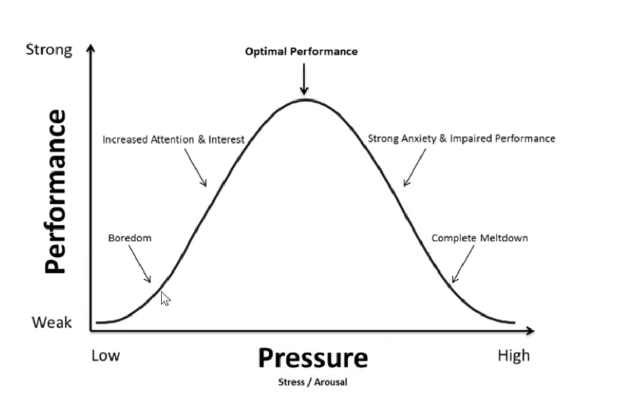
Anxiety and threat
Anxiety: Yerkes-Dodson Law
As arousal passes the ‘optimal point’ (different for everyone), you’re too stressed and performance decreases
As arousal increases, task performance increases – this is motivation
ADHD individuals may already be experiencing significant increased attention and interest and their arousal may be more sensitive. They may frequently use their arousal to initiate tasks that feel difficult to do when bored.
Notes:
Yerkes and Dodson hypothesized that as arousal increases, the ability to form a habit or perform a task well also increases. It gives you sufficient motivation.
But that works only up to a certain point, known as the optimal level. As arousal surpasses that point, your performance begins to deteriorate. You’re too stressed and anxious to do your best.
So, what’s the optimal amount of arousal? That depends on the task and the individual.
A small amount of stress can be helpful for motivation and interest, but this can tip over optimal performance very easily for neurodivergent young people. ADHD individuals may already be experiencing significant increased attention and interest and their arousal may be more sensitive.

Slide 13
Anxiety and threat
Anxiety: Types
Generalised
Panic
Phobias
Worries a lot
Asks ‘what if…?’
Thinks forward
Catastrophises
Rumination
Often sudden onset
Physical symptoms present
Fight/flight/freeze
Panic attacks
Specific focus or trigger
Otherwise not exhibiting anxiety
E.g. test anxiety, spiders
Signs of anxiety you might see:
Procrastination, difficulty concentrating, somatic issues (headache, stomach-ache, heart pounding), tearfulness, stubbornness or resistance to demands, meltdowns, avoidance, perfectionism, irritability, arguing or pushback, hiding, running away, fatigue, increased rejection sensitivity

Slide 14

Anxiety and threat
Anxiety: ADHD
Anxiety is distinct from ADHD, but ADHD often has a significant impact on anxiety levels.
Young people with ADHD often experience low self-esteem and increased frustration, particularly with more complex demands or there are perceived high consequences
Individuals may be often and consistently self-monitoring or masking neurodivergent traits which can result from or cause anxiety.
Executive functioning challenges and the visibility of these to others can cause performance anxiety.
Notes:
Note that students may experience anxiety about lots of things, they might also be experiencing anxiety directly related to having and navigating the work with ADHD.

Slide 15
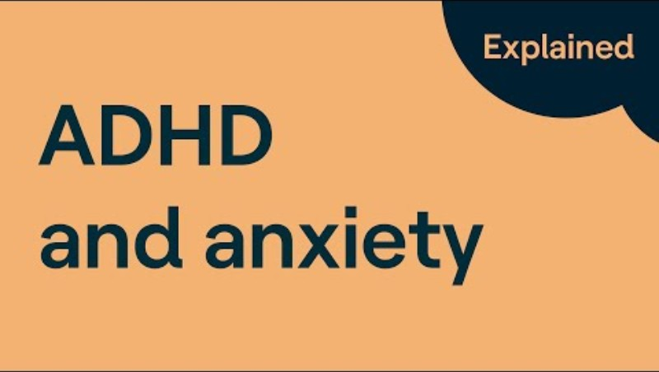
Anxiety and threat
Anxiety: ADHD
Presented by Dr Stephanie Sarkis, Ph.D. NCC DCMHS LMHC, Clinical Specialist in Child and Adolescent Counselling

Slide 16
Anxiety and threat
Anxiety: Strategies to Reduce Anxiety
1. What are some strategies you use to reduce your anxiety?
2. What are some strategies you use in your setting to reduce anxiety for children and young people?
Write your ideas down and be prepared to feedback to the group.
Predictability
Connection
Movement
Choice
Notes:
10 min
Go through each strategy briefly

Slide 17
Anxiety and threat
Anxiety: Strategies to Reduce Threat
Predictability
Connection
Bilateral stimulation
Progressive Muscle Relaxation
squeeze and release
Squeeze the lemon
preview changes
clear first step or instructions
visual or written cues (differentiation)
reframe ‘failure’
name strengths
repair after rupture
build relationships of safety
left and right movement
tapping
rocking
Movement
Choice
Breathwork
Visualizations and Goal-Setting
ball gams/sports
movement breaks
kinesthetic classroom activities
walking while listening
two acceptable options
reduce public performance
co-create exit plans
box/square/star breathing
balloon behind belly breathing
straw
Humming/singing
plans and steps (STAR)
Imaginal thinking
visualization meditations
Modelling how you successfully handle stress or anxiety instead of how you mask it at work can be a powerful learning tool.

Slide 18
Anxiety and threat
What you can do to help
What helps | What this looks like in the classroom
External pause cues | Visual stop signs, countdowns, traffic light cards, clear hand signals before speaking
Reduce inhibition demand | One instruction at a time, predictable routines, fewer last-minute changes
Make waiting visible | Timers, turn cards, adult narration “You’re waiting – you’re next.”
Build in movement | Planned movement breaks, classroom jobs, opportunities to stand and stretch
Regulation before correction | Calm adult response first Problem solving later
Prepare for high-risk moments | Pre-teaching expectations before transitions, games or excitement
Safe outlets for impulses | Fidget tools, movement tasks that don’t disrupt others
Support reflection afterwards | Gentle debriefs once calm
Repair over punishment | Fixing, apologising, retrying
Consistent adult language | Your pause button needs help right now

Slide 19
Every interaction requires analysis…
Masking and relationships
ADHD and Masking
What would a neurotypical person do?
What expression should I make?
How long should I hold eye contact?
Notes:
Neurodivergent people can be hypervigilant to how others perceive them
This can involves having to analyse others body language and rapidly categorise them into a safe or unsafe person ie are they going to judge me/do I have to "behave normally"

Slide 20
Every interaction requires analysis…
Masking and relationships
ADHD and Masking
What would a neurotypical person do?
What expression should I make?
How do I know when to respond or stop talking?
Notes:
Min
Neurodivergent people can be hypervigilant to how others perceive them
This can involves having to analyse others body language and rapidly categorise them into a safe or unsafe person ie are they going to judge me/do I have to "behave normally"

Slide 21
Social adapting or ND masking
Masking and relationships
A) Adapting to the situation | B) Neurodivergent masking
Presenting differently in different settings such as school/home/work/football club
Hiding or suppressing trait is very exhausting
Consistently monitoring behaviour (forcing eye contact, hiding sensory distress, suppressing movement)
Feels isolating – something wrong with me
Often feels like showing different parts or sides of the same person – I am still me
Feels necessary to gain acceptance/be safe when in public
Is usually temporary and does not require someone to hide core self for a significant time
Feels like keeping a big part of yourself secret
Not doing it can have significant negative consequences (discrimination, social ostracization, bullying)
May feel uncomfortable or anxiety inducing in the moment but soon returns to baseline
Wearing long sleeves to cover tattoos in a professional environment
Notes:
4 min
Ask delegates to think about examples of how a NT might make adaptations to situations
and of ND masking, noticing similarities and differences, sorting the statements into one column or another

Slide 22
Social adapting or ND masking
Masking and relationships
Adapting to the situation | Neurodivergent masking
1. Presenting differently in different settings such as school/home/work/football club
1. Presenting differently in different settings such as school/home/work/football club
5. Often feels like showing different parts or sides of the same person – I am still me
2. Hiding or suppressing traits is very exhausting
3. Consistently monitoring behaviour is distressing (forcing eye contact, hiding sensory distress, suppressing movement)
6. Can sometimes feel necessary to gain acceptance/ safety in public
7. Is usually temporary and does not require someone to hide core self for a significant time
4. Feels isolating - something is wrong with me
6. Feels necessary to gain acceptance/safety in public
10. May feel uncomfortable or anxiety inducing in the moment but soon returns to baseline
8. Feels like keeping a big part of yourself secret
9. Not doing it can have significant negative consequences (discrimination, social ostracization, bullying)
11. Example of wearing long sleeves to cover tattoos in a professional environment
Notes:
10 min
Go through the answers to highlight similarities and differences – highlight that neurodivergent masking can cause distress, exhaustion and prolonged anxiety due to its’ intensity
Note that number 6 is in both and this is a generalisation, some NT masking can be highly necessary or distressing but is often not to the degree or as prolonged

Slide 23
Masking and relationships
ADHD and Masking
Masking is safety, not deception Children hide their traits to protect themselves, not to manipulate.
Both perspectives are true The falling apart at home is the direct consequence of managing at school
Masking works until it doesn’t Watch for changes, not just the current moment
Trust comes first Children unmask when they feel safe, not when we tell them to
Your calm response matters more than your perfect response Regulation first, solutions later
Notes:
Note that masking helps indviduals feel safer in their environment – we might want them to feel safe to unmask, but we need to create environments where they feel that way.
In some settings young people are masking considerably, but things fall a part at home where consequences of the extra energy expenditure is felt – this does not mean ‘everything is fine’ just because it ‘appears fine’. We can investigate where the individual is masking considerably or create breaks to lighten the cognitive load.

Slide 24
ADHD: Your Scenario
Work in pairs: think about one pupil or one relevant recurring situation, discuss the questions, then agree one small adjustment to try consistently for two weeks. After two weeks reflect on the implementation.
What might ADHD be making harder?
Is anxiety present, how does it show up and what might this anxiety be protecting them from?
Where might masking be hiding distress or effort?
What one adjustment could we try consistently for two weeks?
Needs-led planning prompts
1. Situation
When and where does the difficulty usually show up?
2. ADHD need
What might attention, regulation or memory be making harder? Think about anxieties and masking demands.
5. Two-week adjustment
What one change, intervention, or support method shall I implement daily, then review?

Slide 25
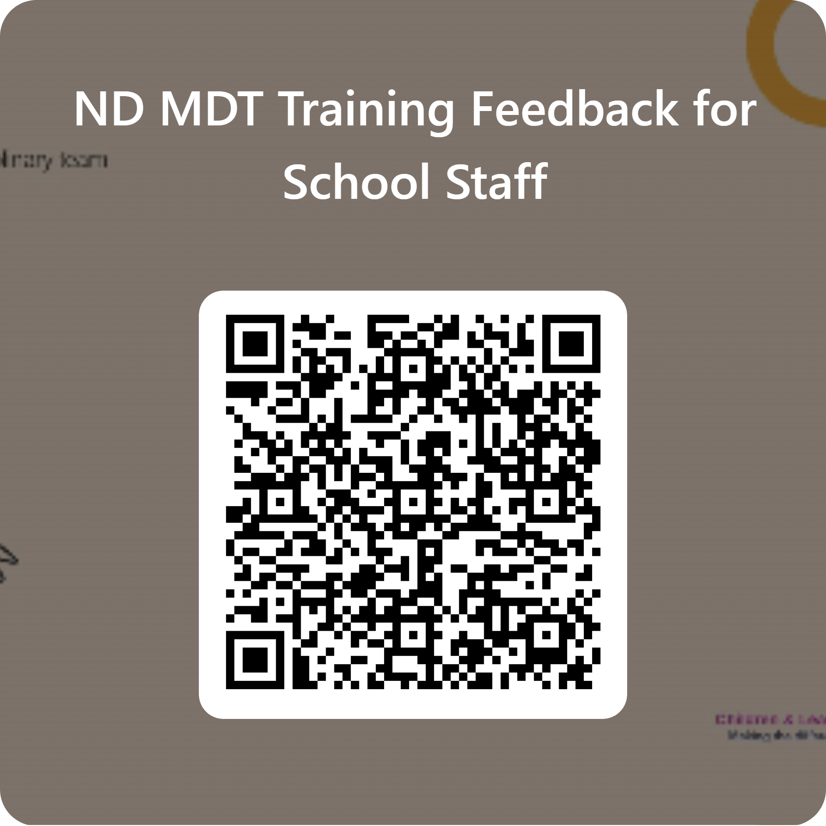
Understanding ADHD: Feedback
Topics - Objectives
ADHD in the classroom
ADHD, anxiety and threat responses
Understanding neurodivergent masking
Practical strategies to support learners with ADHD

