Slide 1
KS1 Reading
Miss Ellis

Slide 2
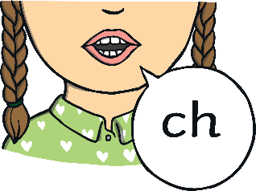
Did You Know…?
The English language has:
X
Y
Z
26 letters
44 sounds
over 100 ways to spell those sounds
It is one of the most complex languages to learn to read and spell.

Slide 3
The Jargon – A Quick Guide
phonics (also known as ‘synthetic phonics’) – The teaching of reading by developing awareness of the sounds in words and the corresponding letters used to represent those sounds.
phoneme - Any one of the 44 sounds which make up words in the English language.
grapheme – How a phoneme is written down. There can be more than one way to spell a phoneme. For example, the phoneme ‘ay’ is spelt differently in each of the words ‘way’, ‘make’, ‘fail’, ‘great’, ‘sleigh’ and ‘lady’.
blending – Putting together the sounds in a word in order to read it, e.g. ‘f – r – o – g, frog’
segmenting – Breaking a word into its constituent sounds in order to spell them, e.g. ‘frog, f – r – o – g’’
Notes:
It can be interesting to see how many ways there are to spell other sounds – try ‘igh’, ‘ee’ or ‘ow’.
A fun way to learn blending with young children is to talk to them in segmented words, for example ‘Please g – e – t’ the ‘m – i – l – k’ out of the ‘f – r – i – dge’.
When children begin to segment to spell they will often use the wrong spelling of phonemes, for example ‘I luv yoo’ or ‘Migh naym is…’. This is not a problem, as the key skill at this stage is that they can hear the sounds in the words and have a go at writing them down.

Slide 4
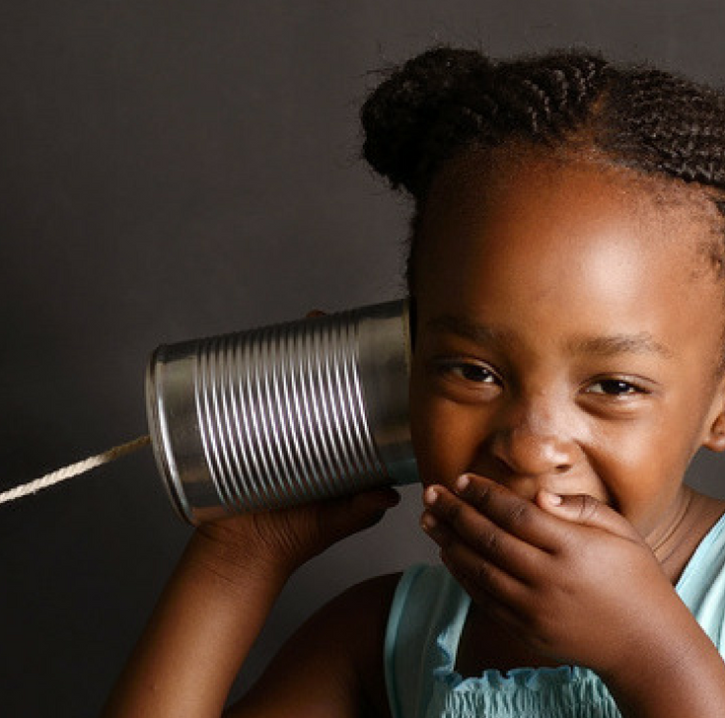
The Importance of Listening Skills
Phonics learning relies on children being able to hear and distinguish the sounds within words.
Children with poor listening and/or attention skills can struggle with phonics learning.
Listening skills begin at birth and there are lots of things that parents and carers can do to support these skills.
Children are also taught listening and attention skills during their early years education (age 0-5).
The first phase of formal phonics education (Phase 1) also focuses on key listening skills. Without these skills, children may struggle to master the next stage of their phonics learning.

Slide 5
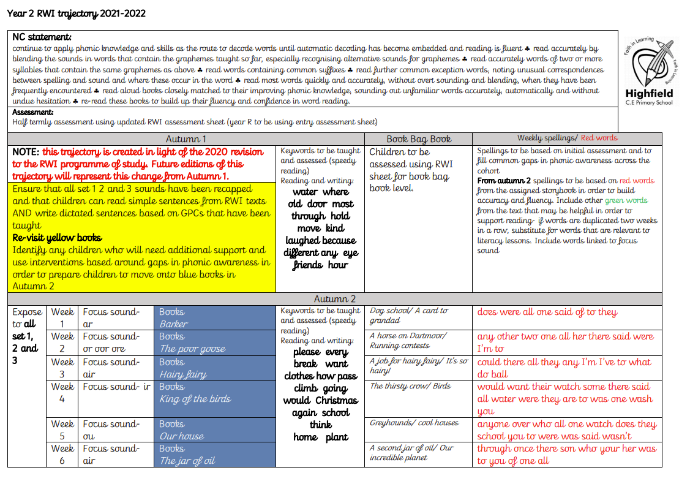
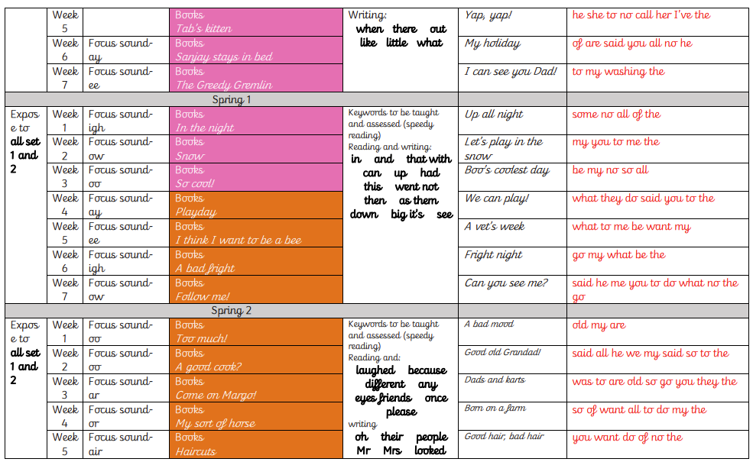
What Is Phonics?
Phonics is a method for teaching reading and writing.
It develops phonemic awareness – the ability to hear, recognise and use the sounds within words.
Learners are also taught the correspondence between sounds and the graphemes (spelling patterns) that represent them.
Phonics is currently the main way in which children in British primary schools are taught to read in their earliest years.
Children will also be taught other skills, such as whole-word recognition (see ‘tricky words’), book skills and a love and enjoyment of reading.
Notes:
Typically, children begin to develop the listening skills essential to phonics in their preschool years. Some children begin to learn letter sounds at preschool but most children will begin their main phonics learning once they start their reception year at primary school (age 4-5). This teaching continues through year 1 (age 5-6) and into year 2 (age 6-7) until the child is a confident and fluent reader.
Once children are fluent readers, the emphasis in reading teaching moves more towards comprehension and analysis skills.
Book skills include holding books correctly, turning pages right to left, recognising that print represents words, talking about pictures, retelling familiar stories, asking and answering questions about stories and non-fiction texts and treating books with respect.

Slide 6
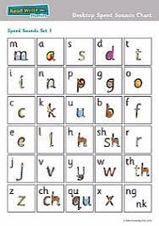
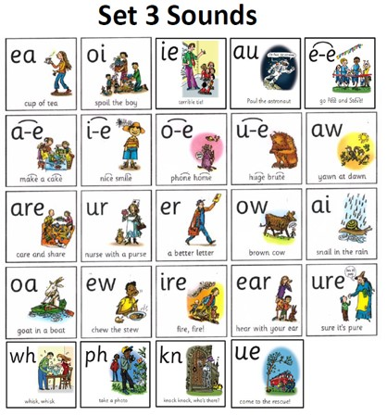
Why Are Children Taught Phonics?
Phonics, taught in a structured way, is generally accepted to be the most effective way to teach reading and writing.
Children learn to hear and recognise sounds in words and spell them correctly.
This assists with their confidence, accuracy and fluency.
Phonics should not be taught in isolation — children also need to learn other reading and comprehension skills alongside phonic knowledge.

Slide 7

The Year 1 Phonics Check
In June, all year 1 children are expected to complete the year 1 phonics screening check.
The aim is to check that a child is making progress in phonics. They are expected to read a mixture of real words and ‘nonsense’ words.
If a child has not reached the expected standard, schools must give additional support to help the child to make progress in year 2.
Notes:
Pupils who have achieved the expected standard at the end of year 1 will have experience of decoding all of the types of words that appear in the year 1 phonics screening check. They will know the correct grapheme to go with most sounds and be able to blend phonemes in words in the screening check.
‘Nonsense’ words or ‘alien’ words are designed to test pure phonic ability rather than knowledge of words. Examples might include ‘baf’, ‘gip’, ‘leet’, ‘stoof’.
For more information about the format of the phonics check, see Twinkl’s ‘Year 1 Phonics Screening Check’ Powerpoint.

Slide 8
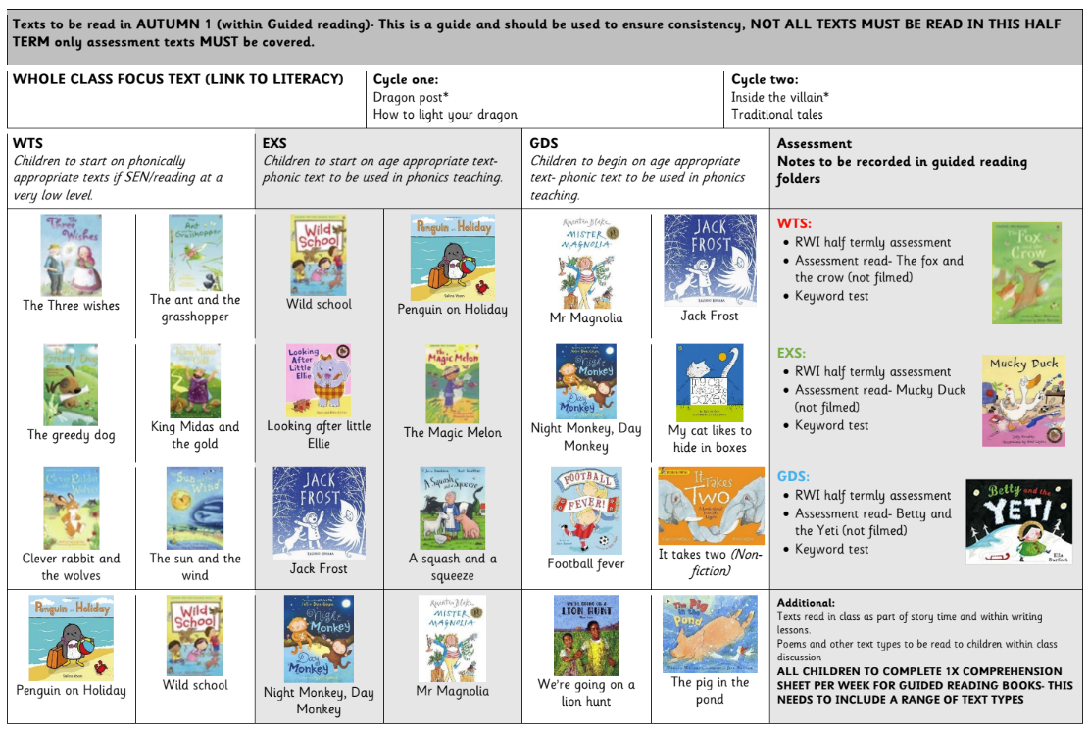
Guided reading in supporting phonics and age appropriate texts
Children will be heard reading twice a week in guided reading sessions.
The books they read will be a mix of age appropriate and stage appropriate texts. This means that some books will be matched to the phonic development of the children, whilst other may be more challenging and be linked instead to the age of the child.
These have been carefully mapped out and will develop and progress with the children as they move through the year.
Notes:
Pupils who have achieved the expected standard at the end of year 1 will have experience of decoding all of the types of words that appear in the year 1 phonics screening check. They will know the correct grapheme to go with most sounds and be able to blend phonemes in words in the screening check.
‘Nonsense’ words or ‘alien’ words are designed to test pure phonic ability rather than knowledge of words. Examples might include ‘baf’, ‘gip’, ‘leet’, ‘stoof’.
For more information about the format of the phonics check, see Twinkl’s ‘Year 1 Phonics Screening Check’ Powerpoint.

Slide 9
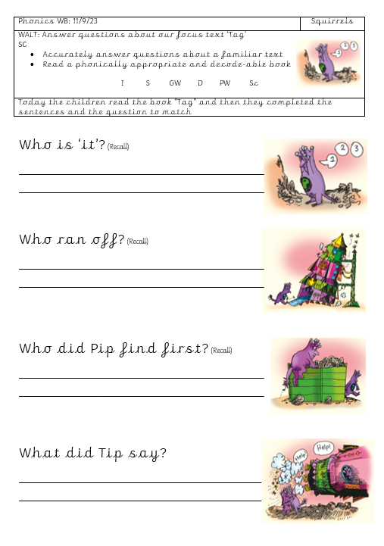
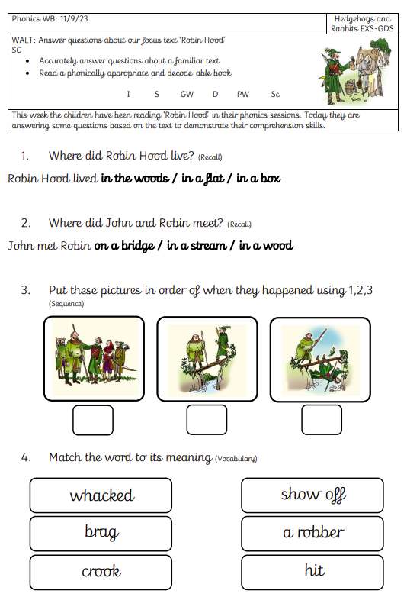
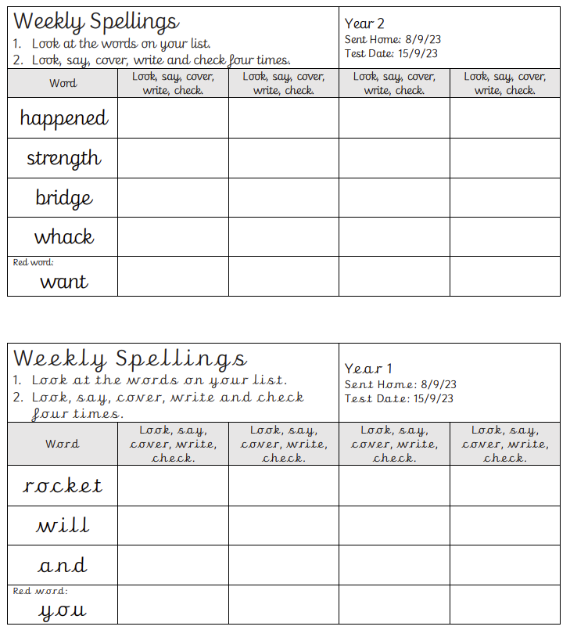
Comprehension tasks and spellings

Slide 10
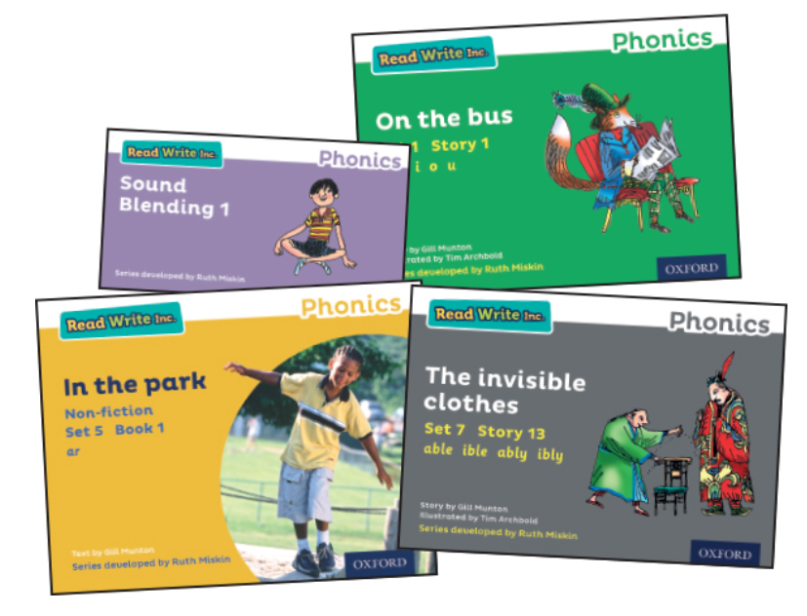
The final phase of Phonics and Beyond
This is mainly taught as children progress through year 2 (age 6-7).
Children are becoming fluent readers and more accurate spellers. They learn more spelling patterns such as the use of prefixes and suffixes, contracted forms of words (e.g. can’t, won’t) and other words in common usage such as days of the week.
At this stage, children can read hundreds of words automatically. They are now reading for pleasure and reading to learn rather than learning to read.
They can decode words quickly and silently and only need to sound out longer or more unfamiliar words.
Notes:
In Phase 6, children will be reading longer and less familiar texts independently and fluently. It is crucial that, at this point, children are now reading to learn and reading for pleasure.
Children should be able to read the 300 high-frequency words. At this point, it is important that comprehension strategies are developed so that children clarify meaning, ask and answer questions about the texts that they are reading, construct mental images during reading and summarise what they have read.
In spelling, children are introduced to the adding of suffixes and how to spell longer words. Throughout the phase, children are encouraged to develop strategies for learning spellings.

Slide 11
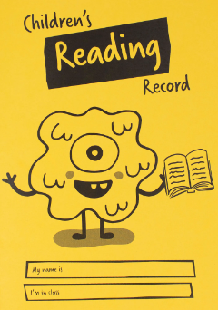
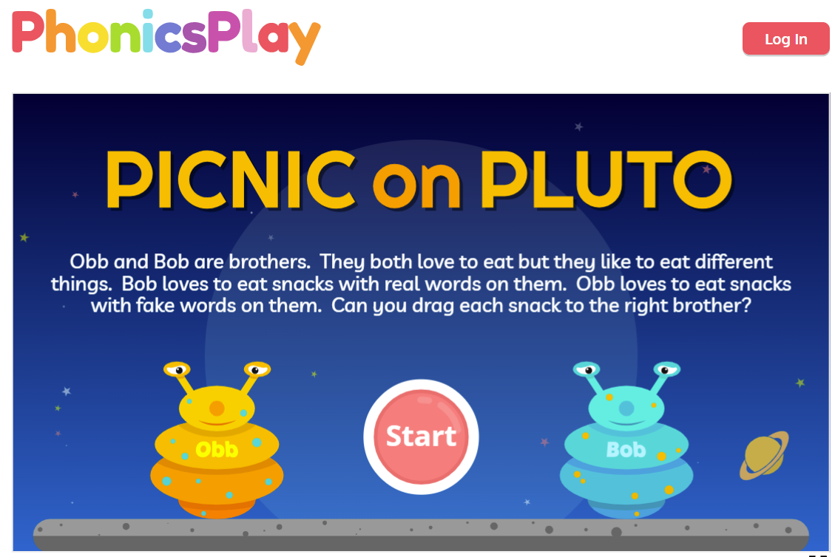
Helping Your Child at Home
Work on listening skills.
Practise real and nonsense words.
Look for familiar sounds and words in the world around you.
Support your child to complete home learning.
Practise new sounds and graphemes.
Read to and with your child every day.

