Slide 1
Year 4 Multiplication check

Slide 2
National Curriculum
Aims:
become fluent in the fundamentals of mathematics, including through varied and frequent practice with increasingly complex problems over time, so that pupils develop conceptual understanding and the ability to recall and apply knowledge rapidly and accurately
reason mathematically by following a line of enquiry, conjecturing relationships and generalisations, and developing an argument, justification or proof using mathematical language
can solve problems by applying their mathematics to a variety of routine and non-routine problems with increasing sophistication, including breaking down problems into a series of simpler steps and persevering in seeking solutions

Slide 3
Year 4 MTC
The multiplication tables check (MTC) is statutory for primary schools in the 2021/22 academic year.
The multiplication tables check (MTC) is statutory for all year 4 pupils registered at state-funded maintained schools, special schools or academies, including free schools, in England.
The purpose of the MTC is to determine whether pupils can recall their times tables fluently, which is essential for future success in mathematics. It will help schools to identify pupils who have not yet mastered their times tables, so that additional support can be provided (the results are used in school).
In 2025, schools must administer the MTC to all eligible year 4 pupils between Monday 2 June and Friday 13 June.

Slide 4
Illness and exemptions
Schools can use the following week, Monday 16 June to Friday 20 June, to administer the check to any pupils who were absent during the first 2 weeks or in case of any delays to the administration of the check due to technical difficulties.
Schools must provide a reason within the MTC service for any pupils who are not able to participate in the check.

Slide 5
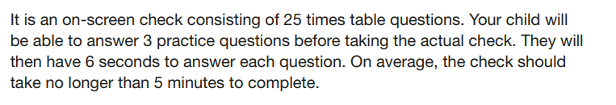
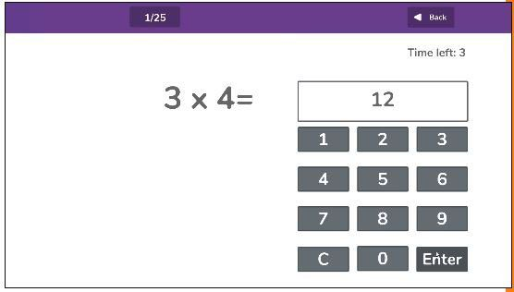

Slide 6

What will it look like at Highfield?
Children will take the test on an ipad
They will sit the test in Mrs Walford/ Mrs Bond’s office so it is quiet
There will be a teacher present
Once the test is done they will return to class

Slide 7
Teaching for Mastery
Access
Pattern
Making connections
Chains of reasoning
Making connections
Representation and structure
Mathematical thinking
Coherence
Small Steps
Variation
Fluency
Number facts
Table facts
Making connections
Procedural
Conceptual
Making connections

Slide 8
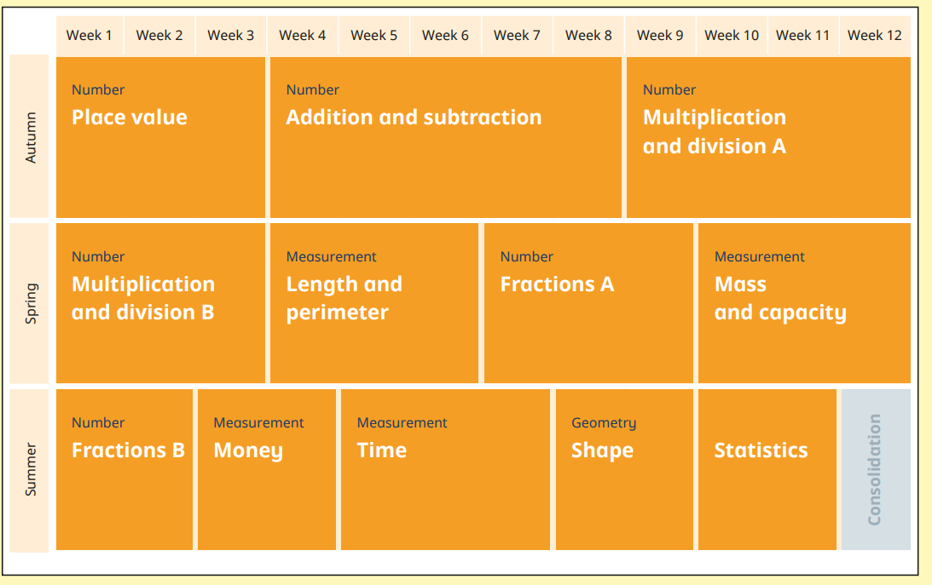
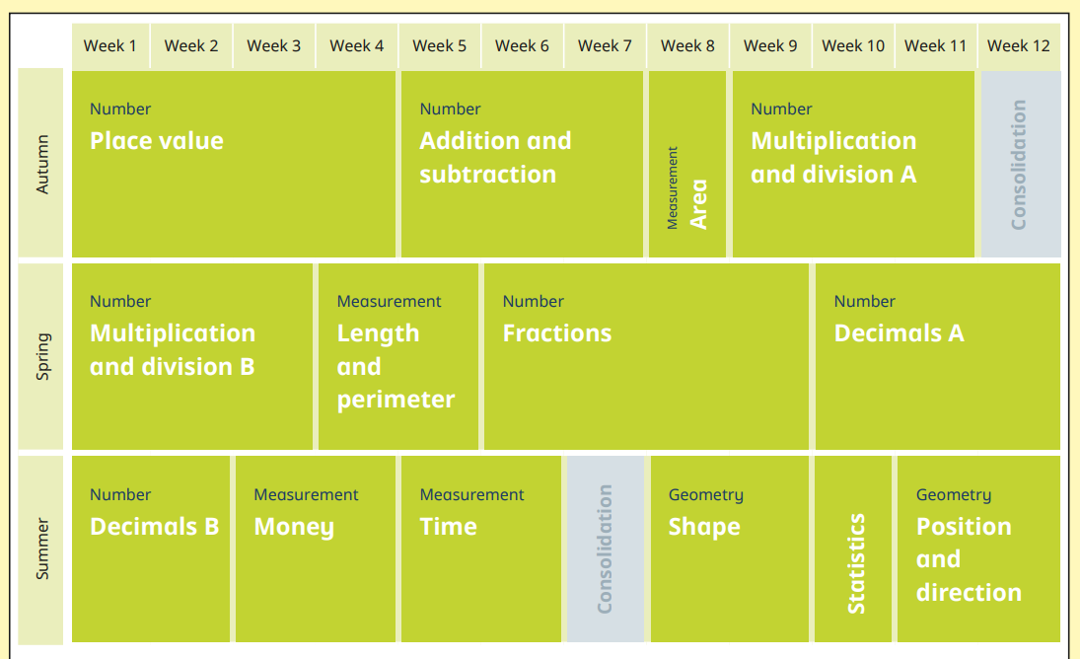
Year 3
Year 4
KS1 | Year 3 | Year 4 | Year 5+
2s, 5s, 10s | 3s, 4s, 8s, | 6s, 7s, 9s, 11s, 12s | All timestables to apply confidently

Slide 9


Support in school | Support at home
10-minutes practice as a morning task Daily practice through the NCETM mastering number programme Weekly time to work on tables as part of prove its to work on teaching of tables. Timestable club before school (coming soon!) Use of timestable rockstar assessment tools (weekly sound checks) and games (rock battles) Weekly rockstar celebration! | Practicing tables at home on timestable rockstar Practice recall in different ways https://www.timestables.co.uk/multiplication-tables-check/ https://ttrockstars.com/

Slide 10

Other ways to keep it exciting!
Number Day – 07/02/25

Slide 11

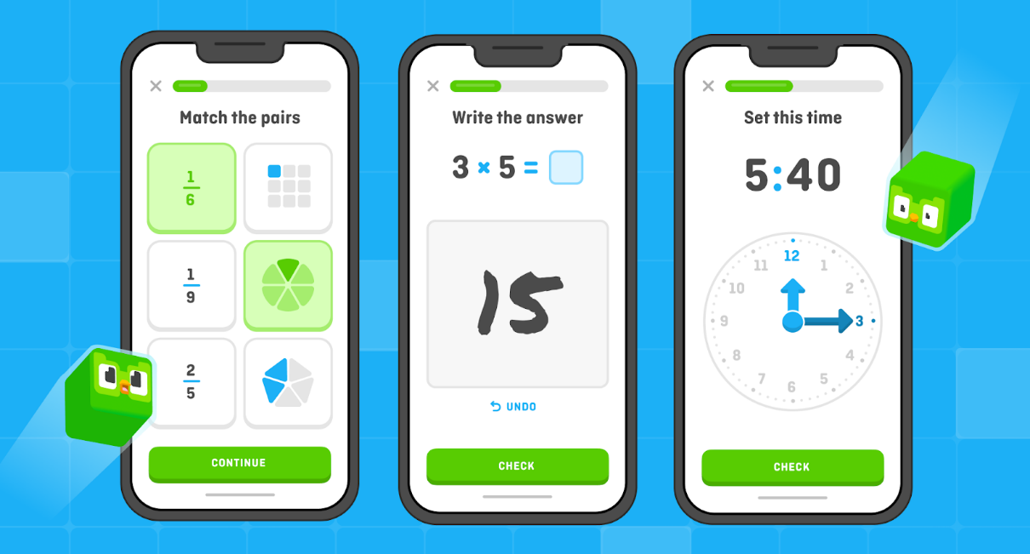
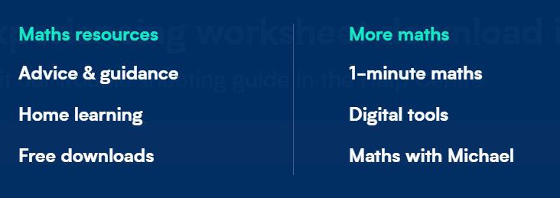

Other ways to help at home
Times Tables - Times Tables Rock Stars doesn’t have to be the only way! Build this into your daily routines.
BBC bitesize
White Rose Parents section
1 minute-maths
https://doodlelearning.com/
https://blog.duolingo.com/new-subjects/

