Slide 1
Greater Depth Writing
In Year 6

Slide 2
Key information about Greater Depth Writing
‘Greater Depth’ is a standard of writing that teachers can judge certain children to be at the end of Year 6.
Unlike for other year groups in primary school, there is an official set of GDS criteria.
In order for their writing to be judged GDS, teachers must be confident that their child can independently write to this standard most of the time. This can be after edits and non-specific teacher feedback.
There are four criteria that we use to judge GDS, and although not all have to be met in every piece of writing, we should be able to see enough examples across a variety of pieces.

Slide 3
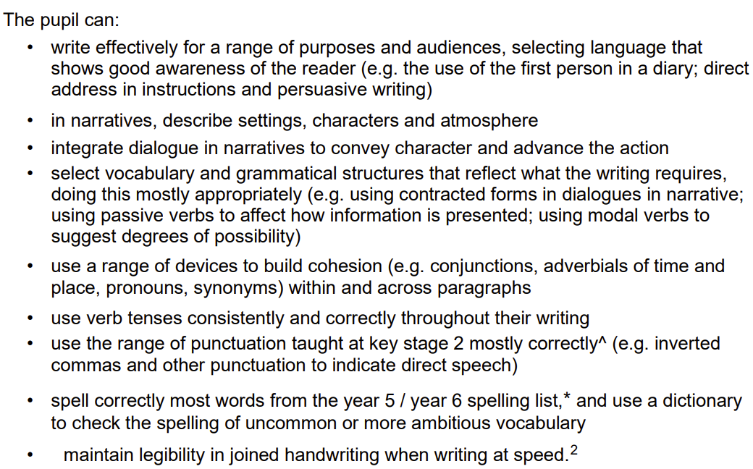
Expected Standards for Year 6 Writing
Before we consider whether a child is writing at Greater Depth, we need to be confident that they can meet the expected standards for the end of KS2:
GDS does not require ‘perfection’ in any of these strands, but we should be confident that children can largely write to this standard independently.

Slide 4
What Constitutes Independence?
Tasks can be set and ideas can be shared around the whole class, but children should choose themselves what to focus on. A teacher might advise, but not direct.
Success criteria should be brief, with no examples.
Feedback / marking should be generalised.
Learning resources should be supplied but not specifically directed to.
Children may also get feedback from a partner.
If done electronically, spelling / grammar checkers are not used.
Children choose their own way to plan.

Slide 5
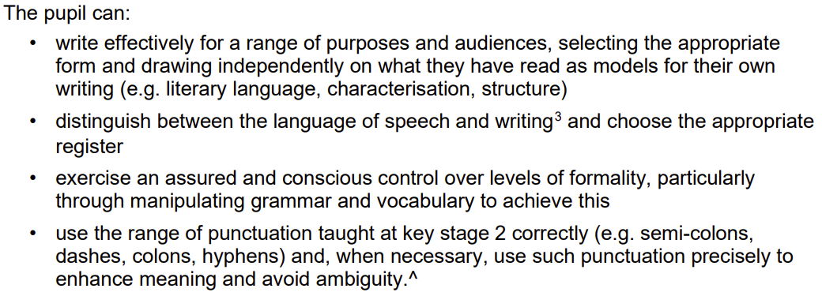
Greater Depth Standards for Year 6 Writing
Highfield has also written its own GDS standards for Years 1-5 too, using the Year 6 standards as a starting point.

Slide 6
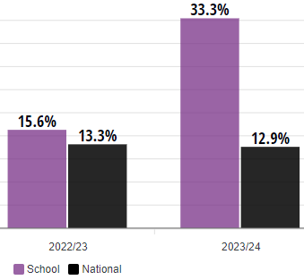
What helped improve our GDS numbers last year?
A new selection of books that we knew the children already loved or would really engage with.
Children reading the books in advance of the unit starting.
Greater focus on writing in the style of a character – to the minute detail!
Grouping of children so that those with the potential for GDS were all together and could receive focused teaching.
Task design that gave the best chance of GDS success.
Focus on specific techniques, beyond the word level, to write formally.
Independent end of year writing projects.

Slide 7
What can you do to help?
Encourage your child to pre-read the texts that we are covering this year.
Engage with your children when they are reading. Listen to them read and talk about how the author has made something funny, scary, tense, and notice where sophisticated punctuation has been used or writing conventions have been bucked!
Have fun talking and writing like book characters, or speaking in an overly formal way!
Expose your child to high quality writing, including texts with formal or archaic language.
Speak to your child about what they are doing in Literacy – what is the journey that they are on, what are they going to be writing at the end, and what have they done so far to help them get there?
Help them with getting to grips with any of the ‘basics’, like spelling and handwriting.

